Slide 1
AI-Based Realistic HR Interview Simulator
Project Guide:
Mr.B.Kishore Babu
Asst. Prof
Batch: CM05
K. Harsha vardhan(Y22ACM446)
B. Beaulah Angel(Y22ACM412)
D. Hemanth(Y22ACM421)
D. Venkata Sanjay(Y22ACM422)

Slide 2
Contents
Abstract
Existing System
Proposed System
Design
Implementation
Results
Conclusion

Slide 3
Abstract
This project presents an AI-based Realistic HR Interview Simulator designed to help candidates practice and improve their interview skills in an interactive environment. The system uses a Large Language Model to dynamically generate role- and domain-specific HR interview questions along with structured reference answers. Candidate responses are captured through speech and video and analyzed using Automatic Speech Recognition, Natural Language Processing, and Computer Vision techniques. These analyses evaluate content accuracy, communication clarity, tone, confidence, and facial expressions. Unlike traditional mock interview systems, the simulator adapts question difficulty based on candidate performance in real time. Finally, it provides a detailed performance report highlighting strengths, weaknesses, and personalized improvement suggestions to enhance job readiness.

Slide 4
Problem Statement
Design and implement AI-powered interview simulation platform that autonomously conducts, evaluates, and reports realistic HR and technical interviews — providing role-adaptive questioning, multi-dimensional scoring, explainable feedback — for both student mock practice and corporate candidate screening.

Slide 5
Existing System
Existing HR interview systems primarily depend on manual interviews or basic AI tools for resume screening and initial candidate evaluation.
Many AI-based platforms use NLP models and chatbots to generate predefined or keyword-based interview questions and assess textual responses only.
Some advanced systems include speech analysis to evaluate tone and sentiment, but this analysis is usually performed after the interview, not in real time.
Facial expression and behavioral analysis are rarely integrated, and when present, they are not utilized for real-time question adaptation.
Most existing systems lack dynamic difficulty adjustment based on a candidate’s responses, performance, or experience level.
Scalability is limited, as traditional and semi-automated systems struggle to handle large numbers of candidates simultaneously.
Overall, current HR interview systems do not offer fully adaptive, multimodal, real-time interview simulations with comprehensive and unbiased candidate assessment.

Slide 6
Research Gap
AI Adaptive question generation
Multi-dimensional scoring
Live video
SHAP explainability
PDF reporting with detailed feedback
HR monitoring dashboard

Slide 7
Proposed system
AI-Powered Intelligent Interview Platform
End-to-end automated interview system integrating AI, ML, and real-time analytics
Simulates real-world technical and HR interviews with adaptive questioning
Provides instant evaluation, feedback, and performance insights
Key Components
Intelligent Question Generation
Behavioral, Technical, Situational, and Cultural-fit models
Dynamic question routing and difficulty calibration
Adaptive Interview Engine
Reinforcement Learning (PPO) adjusts difficulty in real-time
Improves engagement and evaluation accuracy
Data Capture Level
Audio and video responses are captured in real time.
Interview session is continuously tracked and managed.
Recorded data is securely forwarded for processing.

Slide 8
Cont…
Real-Time Multimodal Analysis
Facial expression, voice sentiment, gaze tracking, and posture analysis
Continuous evaluation of confidence, stress, and engagement
AI-Based Proctoring System
Identity verification using face embeddings
Detects cheating (multiple persons, phone usage, suspicious objects)
Generates integrity reports with risk scoring
Explainable AI & Feedback
SHAP-based scoring explanation for transparency
Detailed breakdown of performance across multiple dimensions
Personalized Development Roadmap
4-phase improvement plan (Foundation → Mastery)
Tailored learning paths and skill enhancement strategies

Slide 9
Design
System Architecture & Core Design Decisions
Hybrid Modular Architecture
Three-tier system: React frontend, FastAPI backend, MongoDB persistence
Service-oriented backend with independent modules (AI, Proctoring, Analytics, Reporting)
Real-Time Communication Layer
WebSocket-based bidirectional streaming for live interview interaction
Async event-driven pipeline using asyncio for concurrent processing
Centralized Model Registry Design
Singleton-based model loading to avoid duplication and reduce latency
Multi-provider fallback chain:
Gemini → OpenRouter → vLLM GPU fallback
Two-Phase Evaluation Pipeline
Phase 1: Instant scoring using embeddings + cosine similarity
Phase 2: Deep LLM-based rubric evaluation in background

Slide 10
Cont..
Hybrid Scoring Mechanism
CrossEncoder reranking + keyword coverage + semantic similarity
Score calibration using regression model (human-aligned scoring)
Reinforcement Learning Adaptation
PPO-based RL agent dynamically adjusts:
Question difficulty
Topic switching
Follow-up depth
State includes confidence, stress, performance, and progress
Parallel Processing Strategy
Simultaneous execution:
Answer evaluation
Next question generation
Ensures zero idle time during interviews

Slide 11
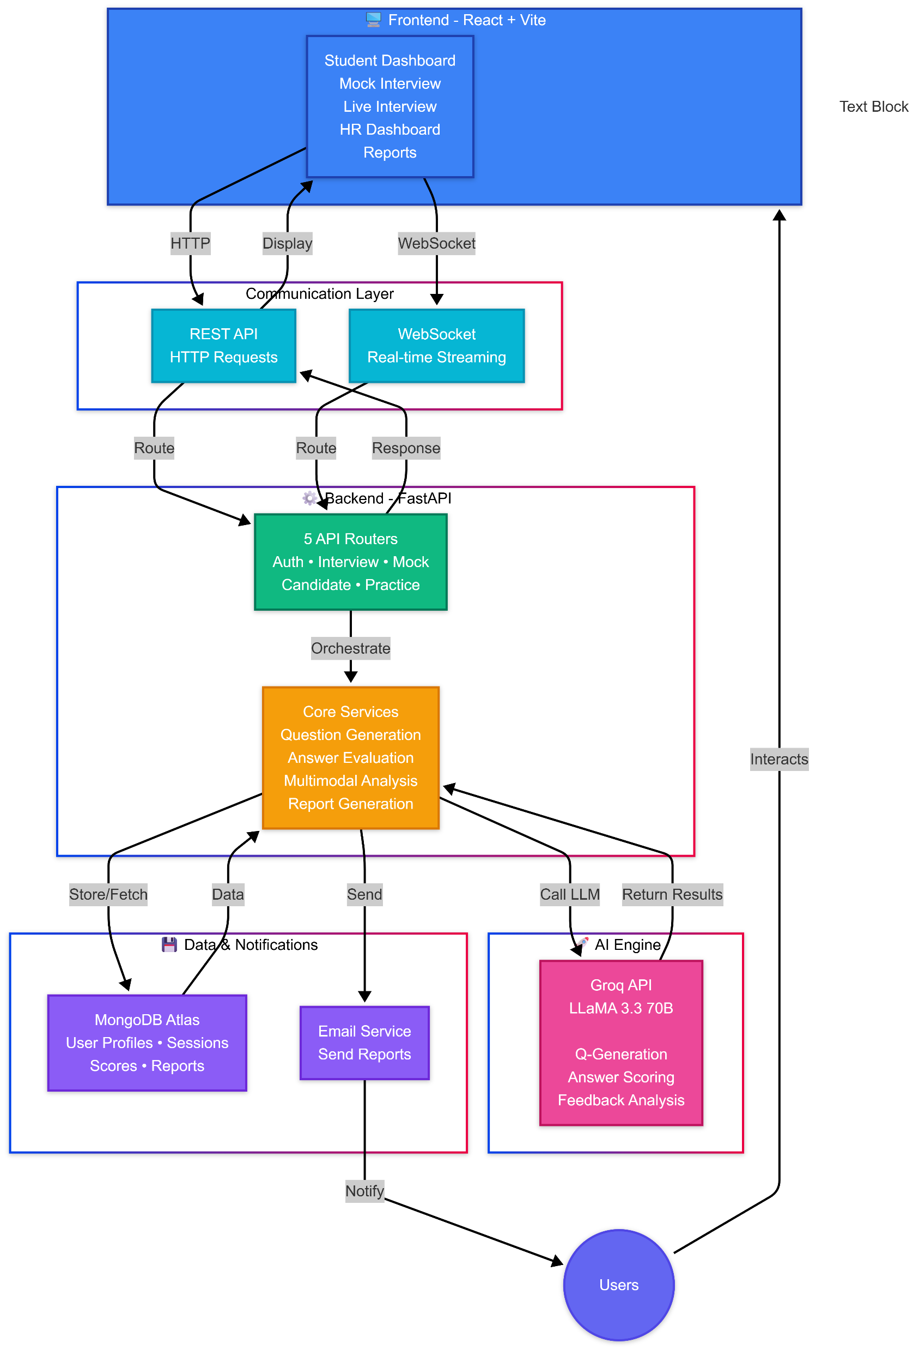

Cont..
Multimodal Analysis Engine
Real-time fusion of:
Facial expressions
Voice sentiment
Eye tracking (gaze FSM)
Speech fluency
Attention-based temporal fusion with
sliding window modelling
Advanced Proctoring Framework
Face verification using embeddings
YOLO-based object detection
(phone, multiple persons)
Risk scoring engine for integrity monitoring
Explainability & Feedback Design
SHAP-based feature attribution for transparent scoring
Generates human-readable feedback across 5 dimensions
LLM

Slide 12
Implementation
Tech Stack & Development Environment
Frontend: React 18 (Vite), TailwindCSS, Recharts — built as a Single Page Application with voice-first UX
Backend: Python 3.11 with FastAPI (async), Uvicorn ASGI server, Motor (async MongoDB driver)
Database: MongoDB Atlas — stores sessions, questions, responses, proctoring logs, and user profiles
LLM Chain: Gemini 2.5 Flash (primary) → OpenRouter free models → vLLM self-hosted on Modal GPU
ML Libraries: sentence-transformers (all-MiniLM-L6-v2), scikit-learn (CrossEncoder, IsotonicRegression), DeepFace, YOLOv8 (Ultralytics)
Speech Pipeline: Vosk STT (server-side, real-time PCM streaming via WebSocket) + Web Speech API fallback; TTS via browser SpeechSynthesis
Real-Time Video Monitoring: LiveKit Cloud for WebRTC-based HR monitoring dashboard

Slide 13
Cont..
LLM Question Generation
Four dedicated generator functions in question_generation_service.py: generate_behavioral_question(), generate_technical_question(), generate_situational_question(), generate_cultural_fit_question()
Each function calls model_registry.llm_generate() with a structured prompt enforcing a strict JSON output schema containing question, ideal_answer, evaluation_keywords, and follow-up conditions
generate_question_smart() acts as the router — selects model based on question_number / total_planned ratio (progress %) and round type (Technical / HR)
Coding question injection logic: max 2 coding questions per session; probability decays with each coding Q asked
Redundancy check: New question embedding compared to all previous via cosine similarity; threshold = 0.75; rejected and regenerated if too similar
JD analysis pipeline: analyze_job_description() extracts required_skills, technical_topics, and hr_topics from the JD text and injects them into every prompt
Fallback on LLM failure: Predefined static question pools per round type are used if all LLM providers fail

Slide 14
Cont..
Two-Phase Answer Evaluation
Phase 1 (Instant, <2s): Runs entirely on local models — no LLM call; uses CrossEncoder ms-marco-MiniLM-L-6-v2 for content scoring; SentenceTransformer for keyword embedding matching with WordNet synonym expansion
Communication score computed via heuristic: word count → sentence count → structural marker detection (e.g., "firstly", "therefore", "for example")
Confidence score: analyze_text_confidence() counts hedging words (maybe, I think, sort of) and absolute words (definitely, always) to infer conviction level
Phase 2 (Deep, background async): _evaluate_rubric() calls Gemini with a 5-dimension rubric (accuracy, completeness, depth, relevance, clarity); combined as weighted sum
Score calibration: ScoreCalibrator uses IsotonicRegression trained on 50-sample human-expert validation dataset to correct AI politeness bias
Background enrichment: _enrich_evaluation_in_background() runs as a FastAPI BackgroundTask — updates the MongoDB document with deep scores without blocking response

Slide 15
Cont..
RL Adaptation — From Theory to Code
Environment: InterviewEnvironment, 8D state: confidence, performance, stress, difficulty, time, coverage, streak
Actions (6): easier, same, harder, switch topic, deeper follow-up, supportive
PPO Agent: NumPy linear policy; trained 200 episodes on simulated candidates
Guardrails:
Stress ≥0.85 → force supportive
Performance ≤0.25 → block harder
Difficulty cooldown: ≥2 questions between changes
AI Proctoring — Modules & Integration
Face Registration: 7 frames captured → DeepFace (Facenet512) → 512-d embeddings averaged as reference
Identity Check: Every 4s → cosine similarity vs reference (threshold 0.40); skipped if head turned
Object Detection: YOLOv8n detects phone (67), book (73), remote (65); person ≥2% frame area
Multi-person Logic: Violation logged only after 2 consecutive detections
Gaze FSM: ATTENTIVE → WARNING → RECOVERING; trigger if deviation ≥4s (≥70% of 10 frames)

Slide 16
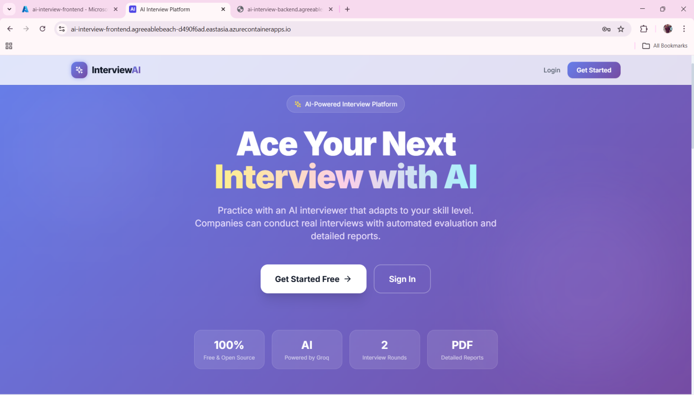
Results
Landing Page Public-facing landing page of InterviewAI — supports two modes: student self-practice and corporate HR-conducted interviews

Slide 17
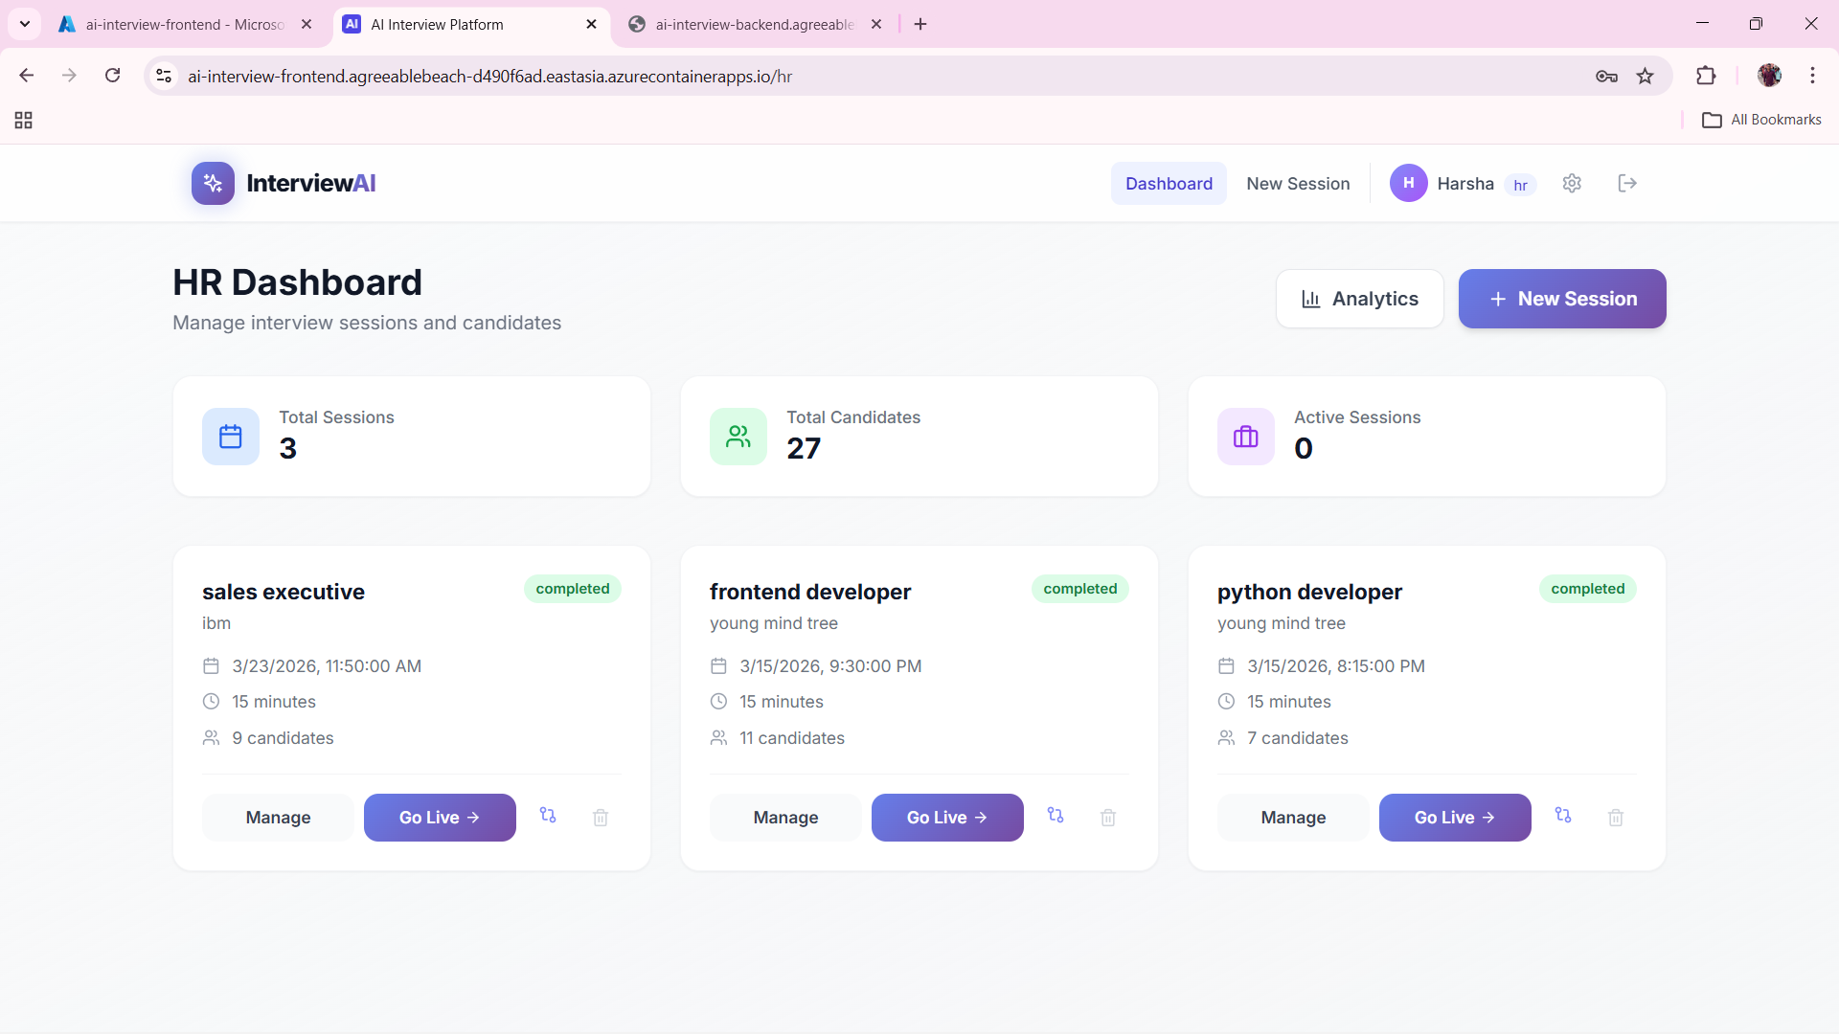
Cont..
HR Dashboard helps the HR team see all interview activity in one place.It shows candidate status, scores, and pending tasks for quick follow-up.This makes hiring faster, clearer, and easier to manage.

Slide 18
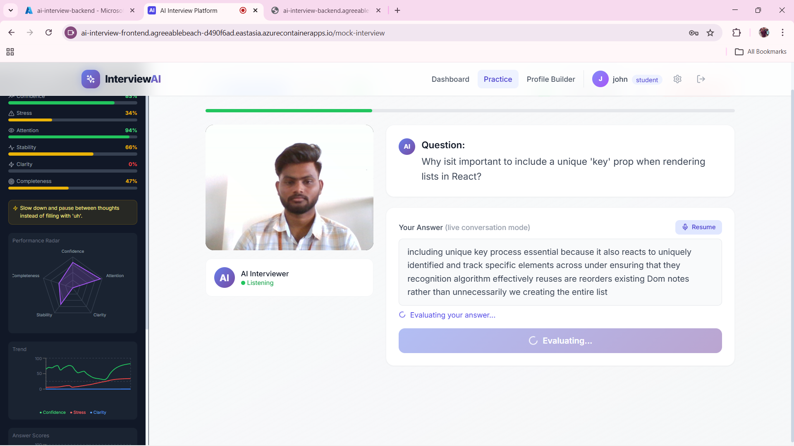
Cont..
Practice Interview Interface lets users attend a live AI mock interview with real-time video, question prompts, and answer input in one screen. The page tracks communication metrics like attention, stress, clarity, and confidence to give instant performance feedback during the session. It helps candidates improve speaking quality, technical response structure, and interview readiness through continuous AI evaluation.

Slide 19
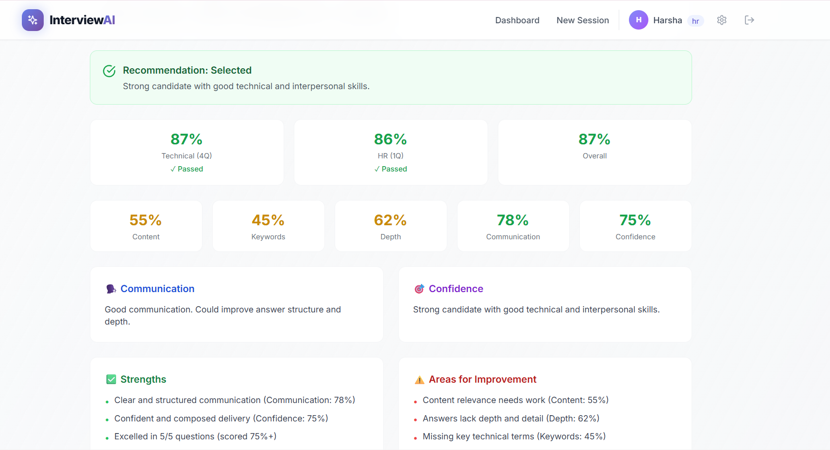
Cont..
Interview Results Dashboard gives a complete summary of candidate performance across technical, HR, and overall evaluation scores. It highlights key communication metrics, confidence level, and skill depth, along with clear strengths and areas that need improvement. The page supports faster hiring decisions by combining recommendation status, score breakdowns, and actionable feedback in one view.

Slide 20
Conclusion
The AI-Based Realistic HR Interview Simulator transforms traditional interviews into an intelligent, adaptive, and unbiased process. By integrating technologies like FastAPI, React.js, YOLOv8, DeepFace, and SHAP, the system enables real-time adaptive questioning, multimodal evaluation, and explainable scoring.
It reduces human bias, saves HR screening time, and provides structured, actionable feedback for candidates. Overall, the project delivers a scalable, transparent, and future-ready AI-driven interview solution.

Slide 21
ANY QUERIES?

Slide 22
THANK YOU

